Slide 1
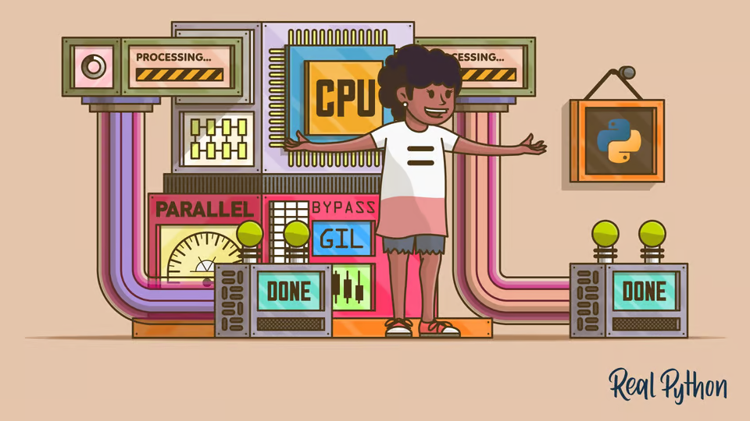

Процеси у Python

Slide 2

Kahoot Time!

Slide 3
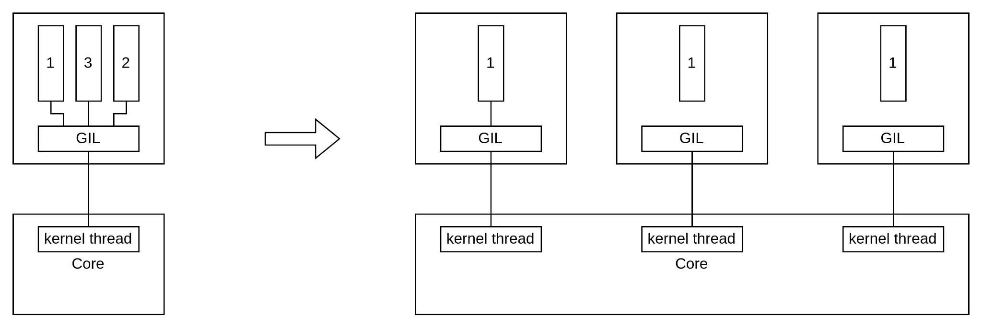
GIL workaround

Slide 4
Process creation
Class
Functor
Function

Slide 5
Context and start methods
Spawn !(if you are windows user you have only it. It copies only needed)
Fork !( fork does not copy the parent process's threads, but copy anything else)
Forkserver

Slide 6
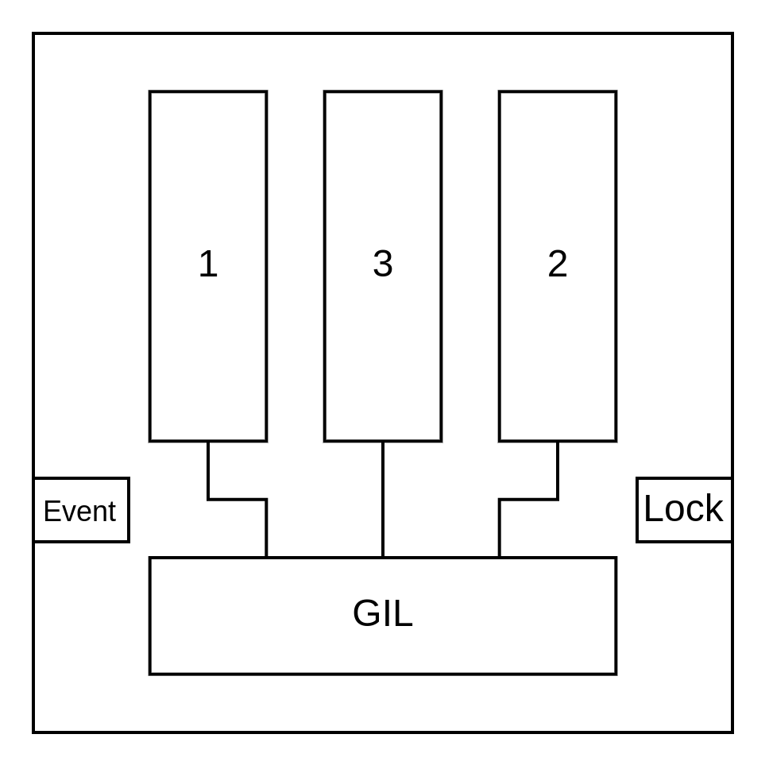
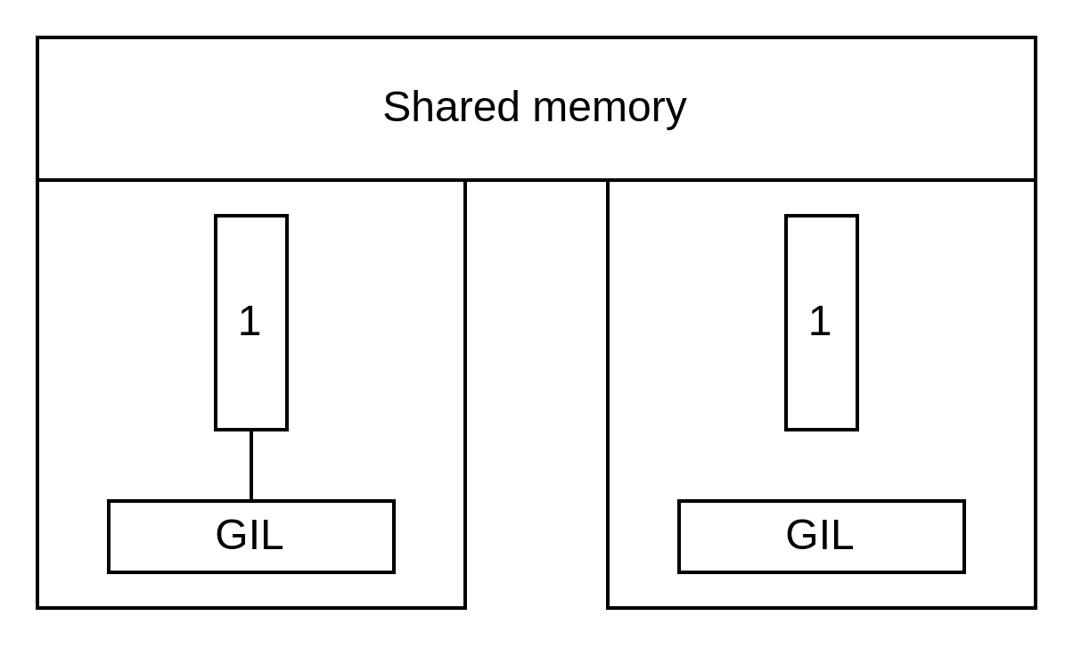
IPC. Shared Memory

Slide 7
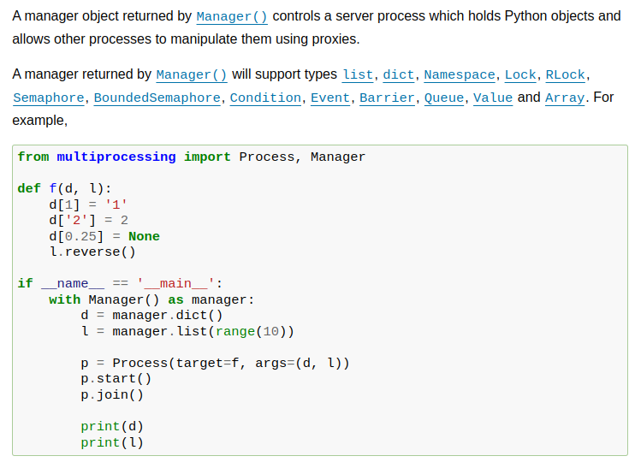
IPC. Shared Memory

Slide 8
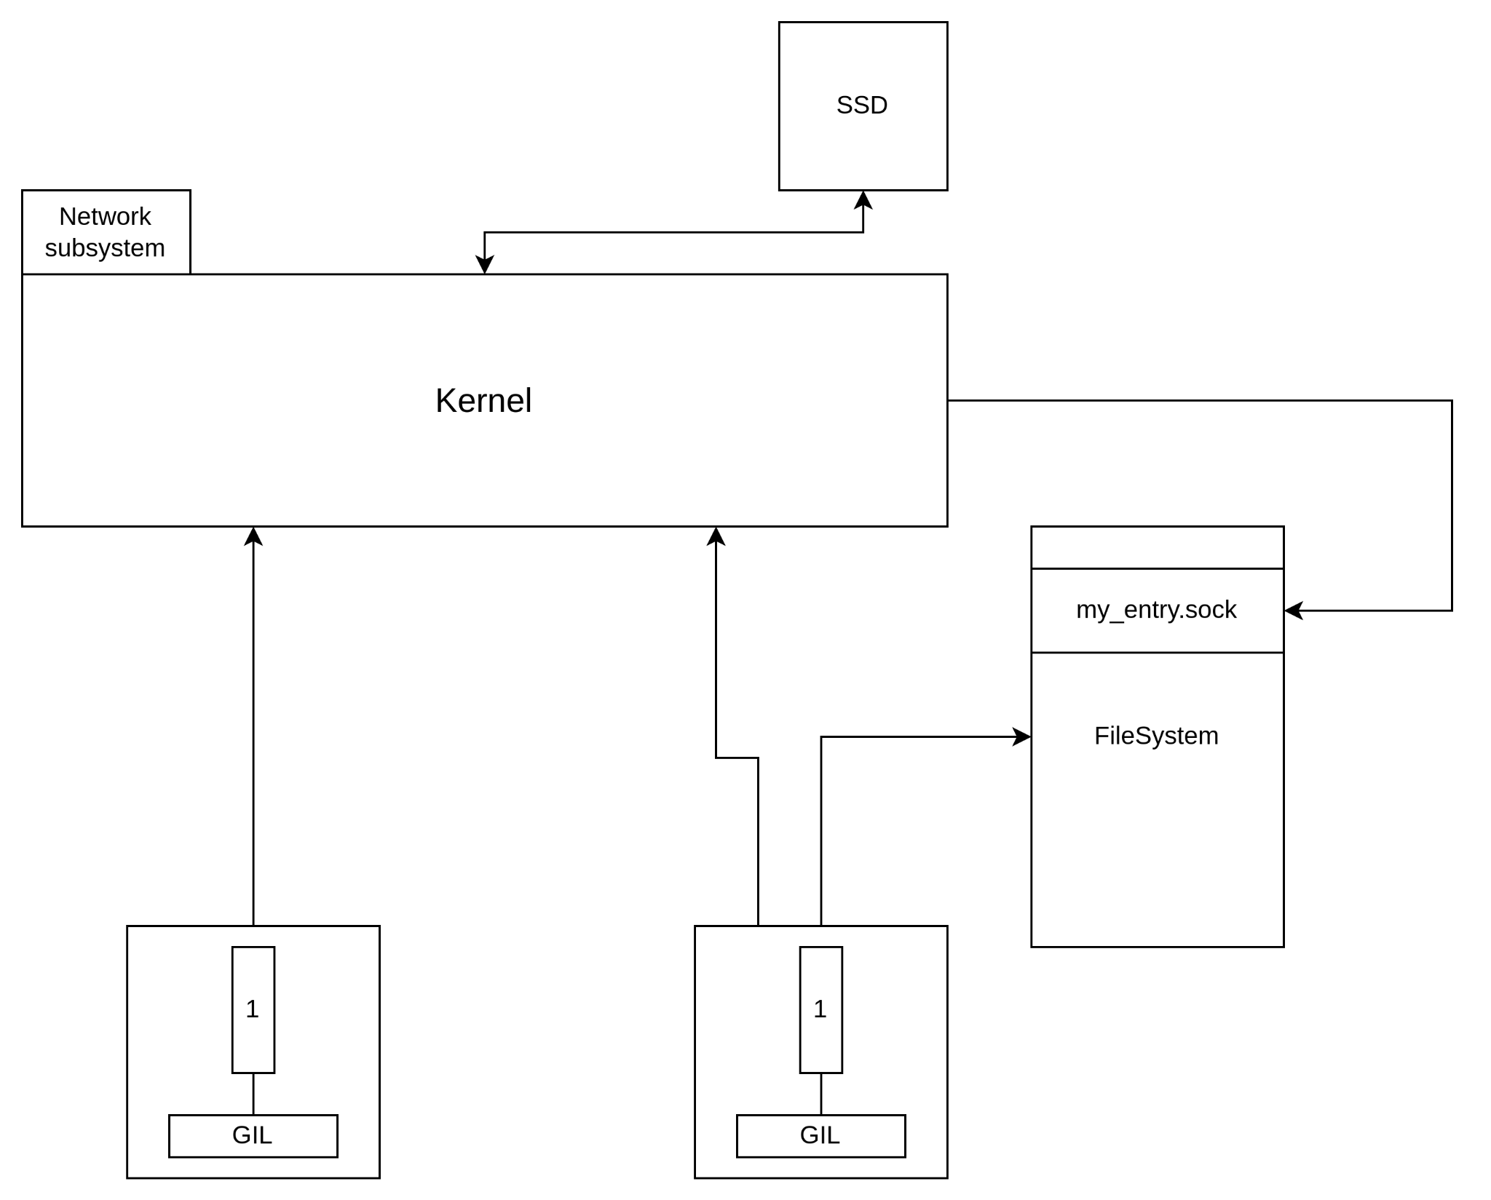
IPC. Files/Named Pipes/Sockets/Pipes

Slide 9
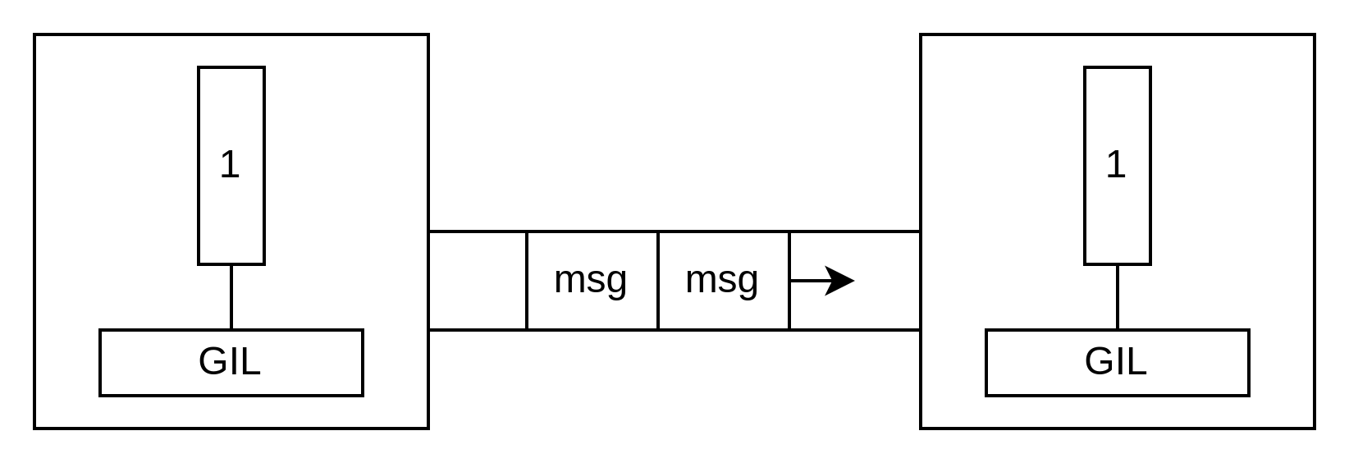
IPC. Files/Named Pipes/Sockets/Pipes

Slide 10
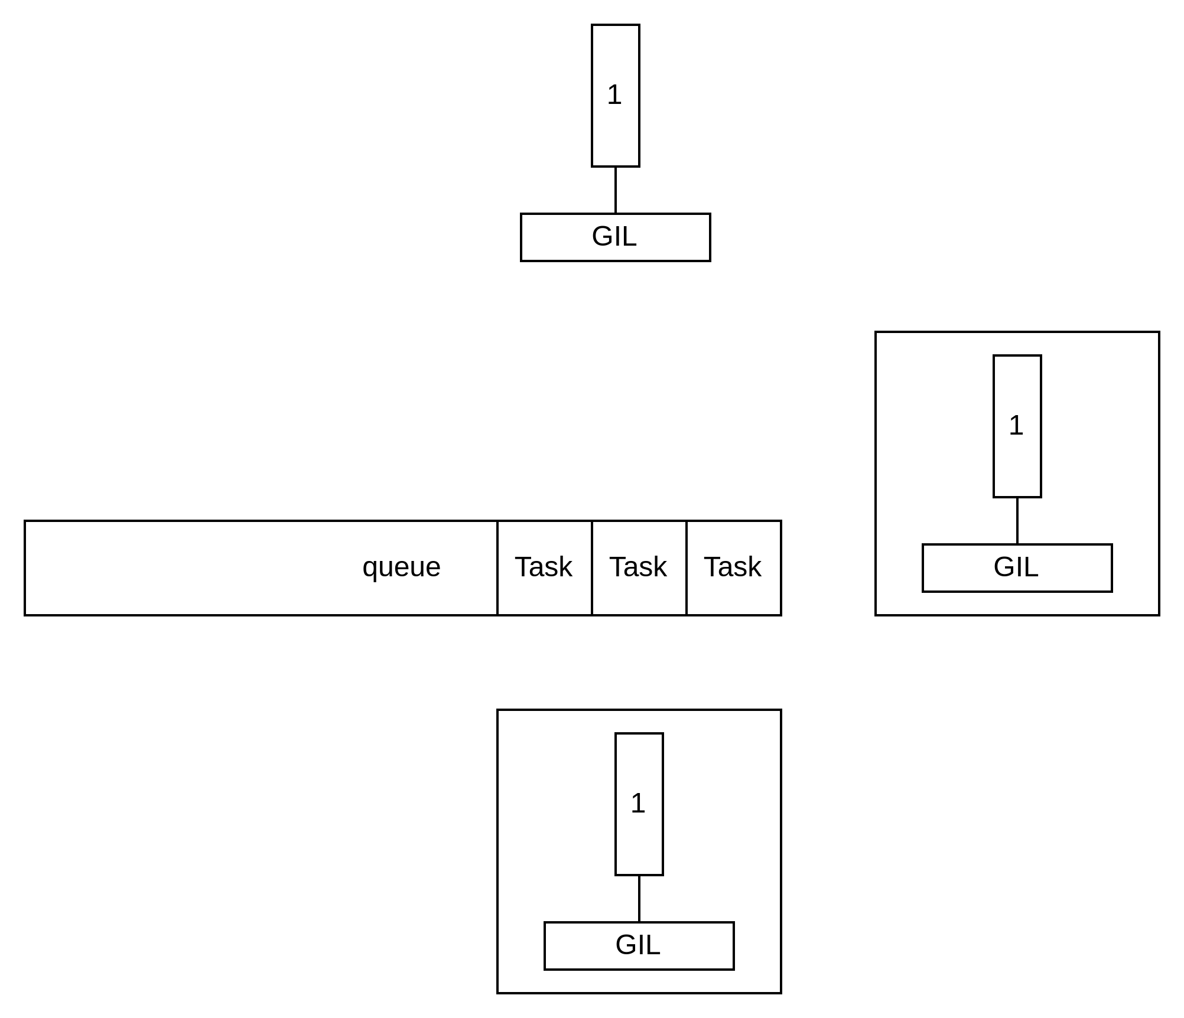
IPC. Process Pool

Slide 11

Дякую

